Slide 1

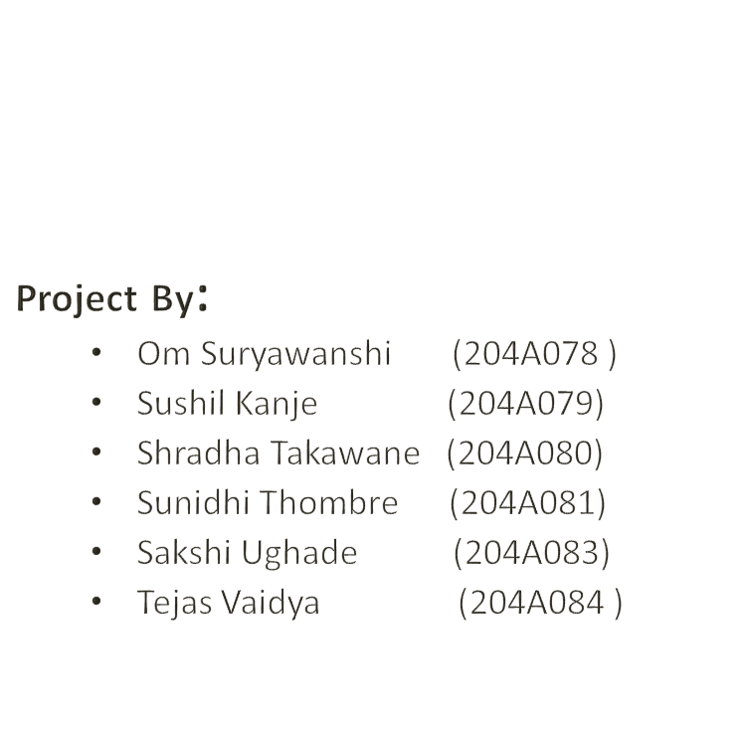

SINHAGAD COLLEGE OF ENGINEERING ,PUNE- 41.
DEPARTMENT OF ELECTRONICS & TELECOMMUNICATION ENGINEERING
Under Guidance : Prof. Rohini Katkar

Slide 2
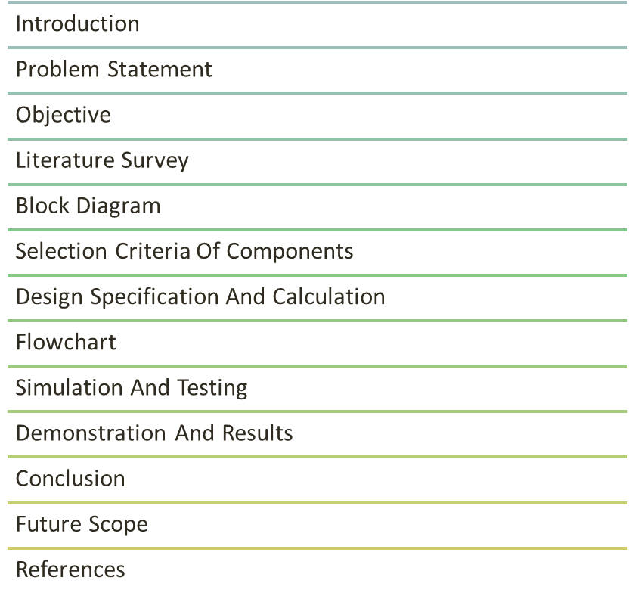
CONTEnTS

Slide 3
INTRODUCTION
This project aims to design and develop a secure and reliable locking system that uses fingerprint recognition technology to provide access control
This is a modern and advanced technology that will help you secure your home or office in a more convenient way. The fingerprint door lock project is an innovative security solution that uses biometric technology to control access to a building or room. This means that only authorized individuals whose fingerprints have been registered in the system can gain entry.

Slide 4
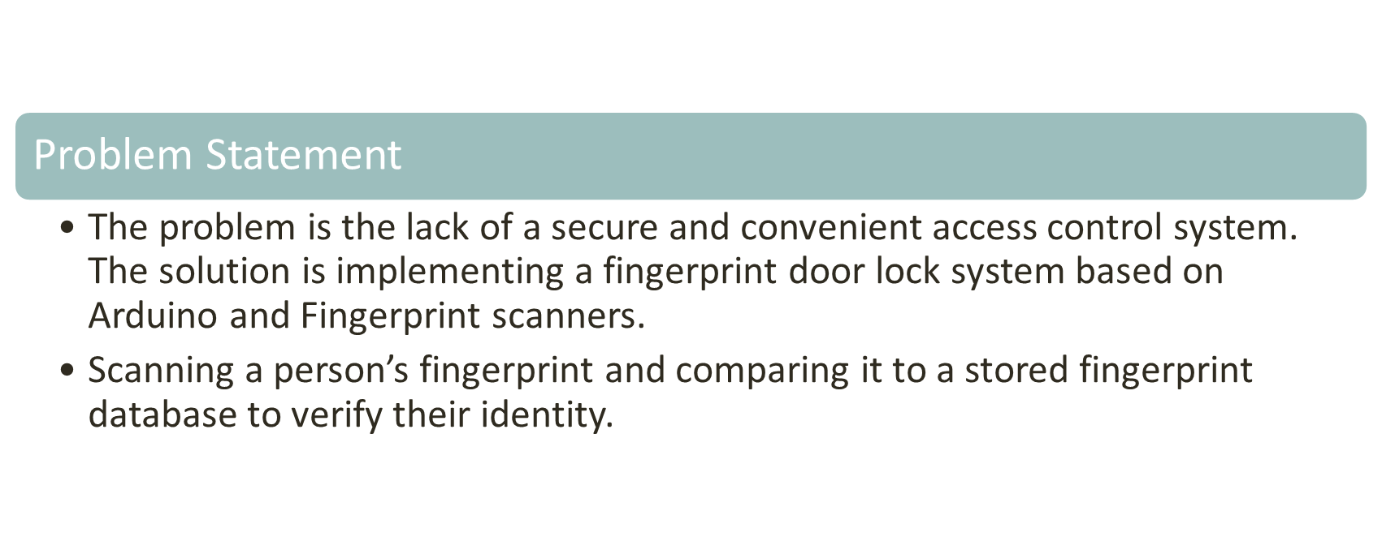

Slide 5
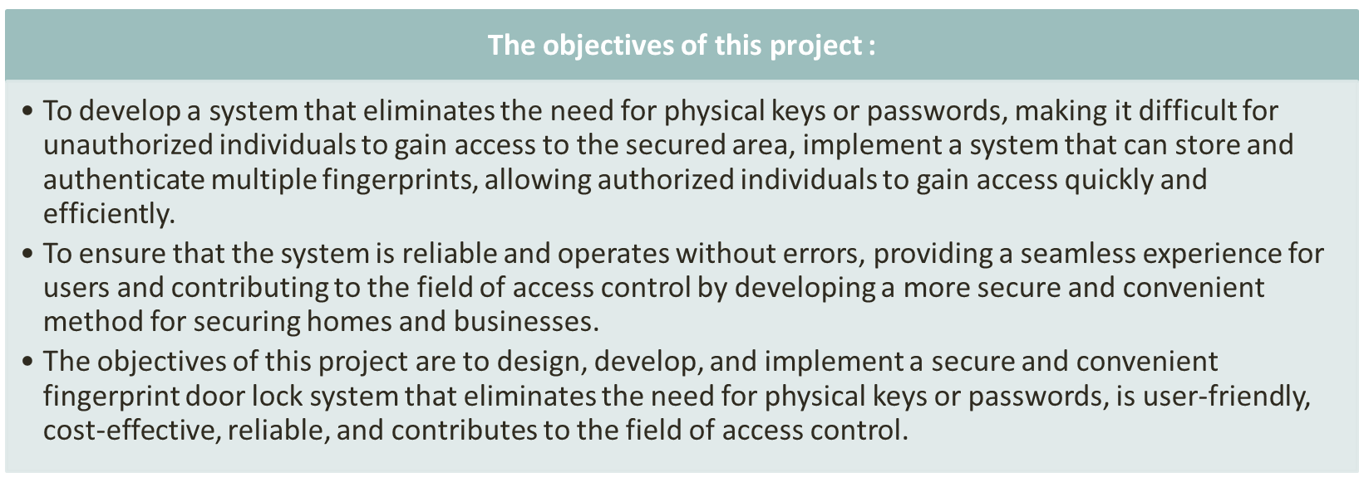
OBJECTIVE

Slide 6
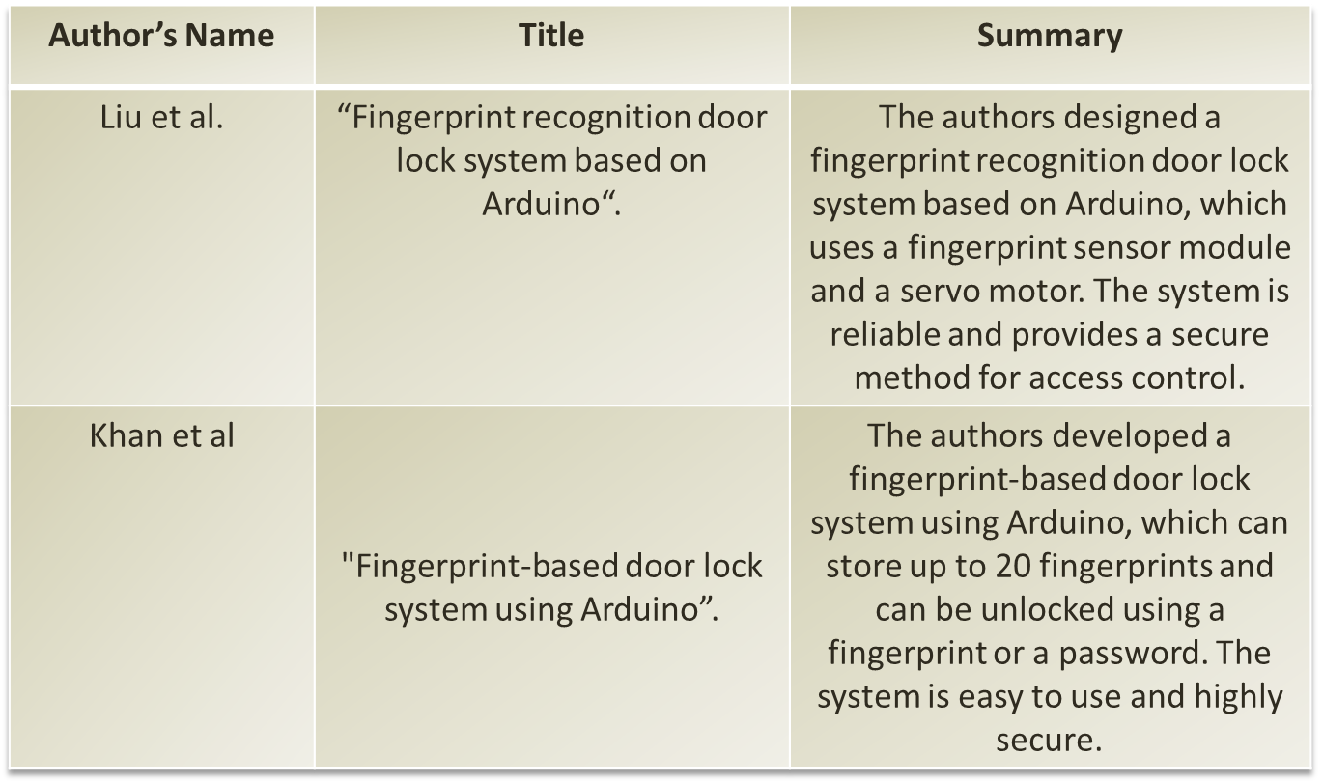
Literature survey

Slide 7





BLOCK DIAGRAM

Slide 8
Selection criterion of components
Fingerprint Sensor: The fingerprint sensor is the most critical fingerprint door lock project component. It should be reliable, accurate, and responsive. Different types of fingerprint sensors are available in the market, such as optical, capacitive, and ultrasonic. We have used an optical fingerprint sensor.
Microcontroller: The microcontroller is the brain of your project. It should have enough processing power to handle the fingerprint sensor and other components of the project. The microcontroller we used for the fingerprint door lock is Arduino.
Servo Motor: A servo motor is a type of motor commonly used in robotics, automation, and other motion control applications. Unlike other types of motors, such as DC motors or stepper motors, a servo motor is designed to provide precise control over its rotational position and speed.
Power Supply: The power supply is a critical component of any electronic project. A reliable and stable power supply that can provide enough power to run all the components of the project is required.
Wiring and Connectors: The wiring and connectors should be high quality and reliable. They should be able to handle the power and data requirements of the project.
Wooden block and door lock notch: We have also used wooden block and door lock notch.

Slide 9
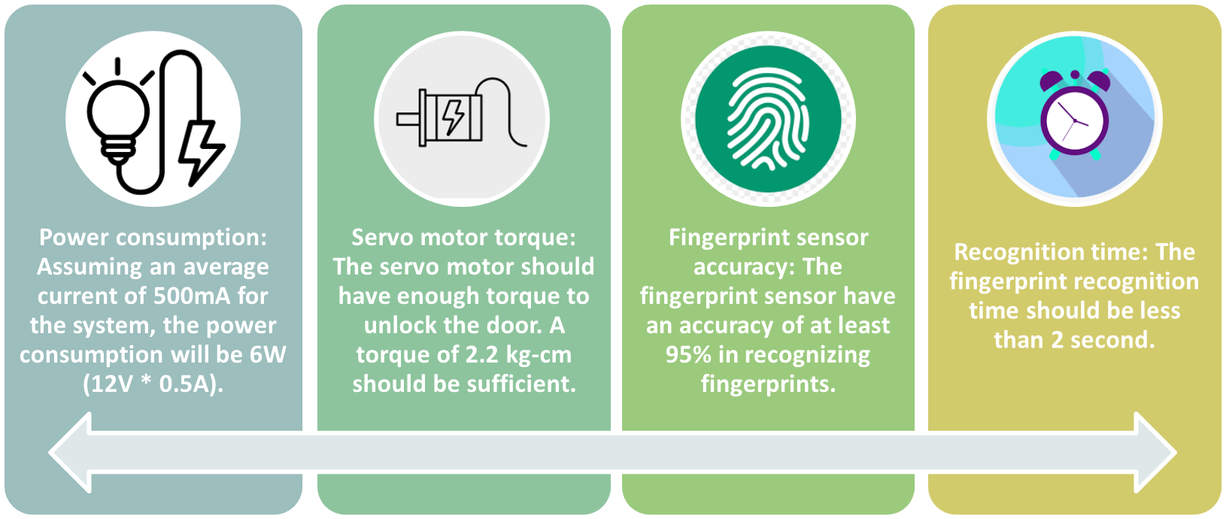
Design specification &calculation

Slide 10
flowchart
Activation
Initialization of module and serial port
Realisation a handshake
Ignoring all commands
Enter ID
Scan of the fingerprint and generate an image
If is mistake
If is mistake
Conversion of scan on the pattern
Scan of the fingerprint and generate an image
If is mistake
If is mistake
Conversion of scan on the pattern
Creation of template file and save to the temporary memory
Saving the template to the permanent memory and adding ID

Slide 11
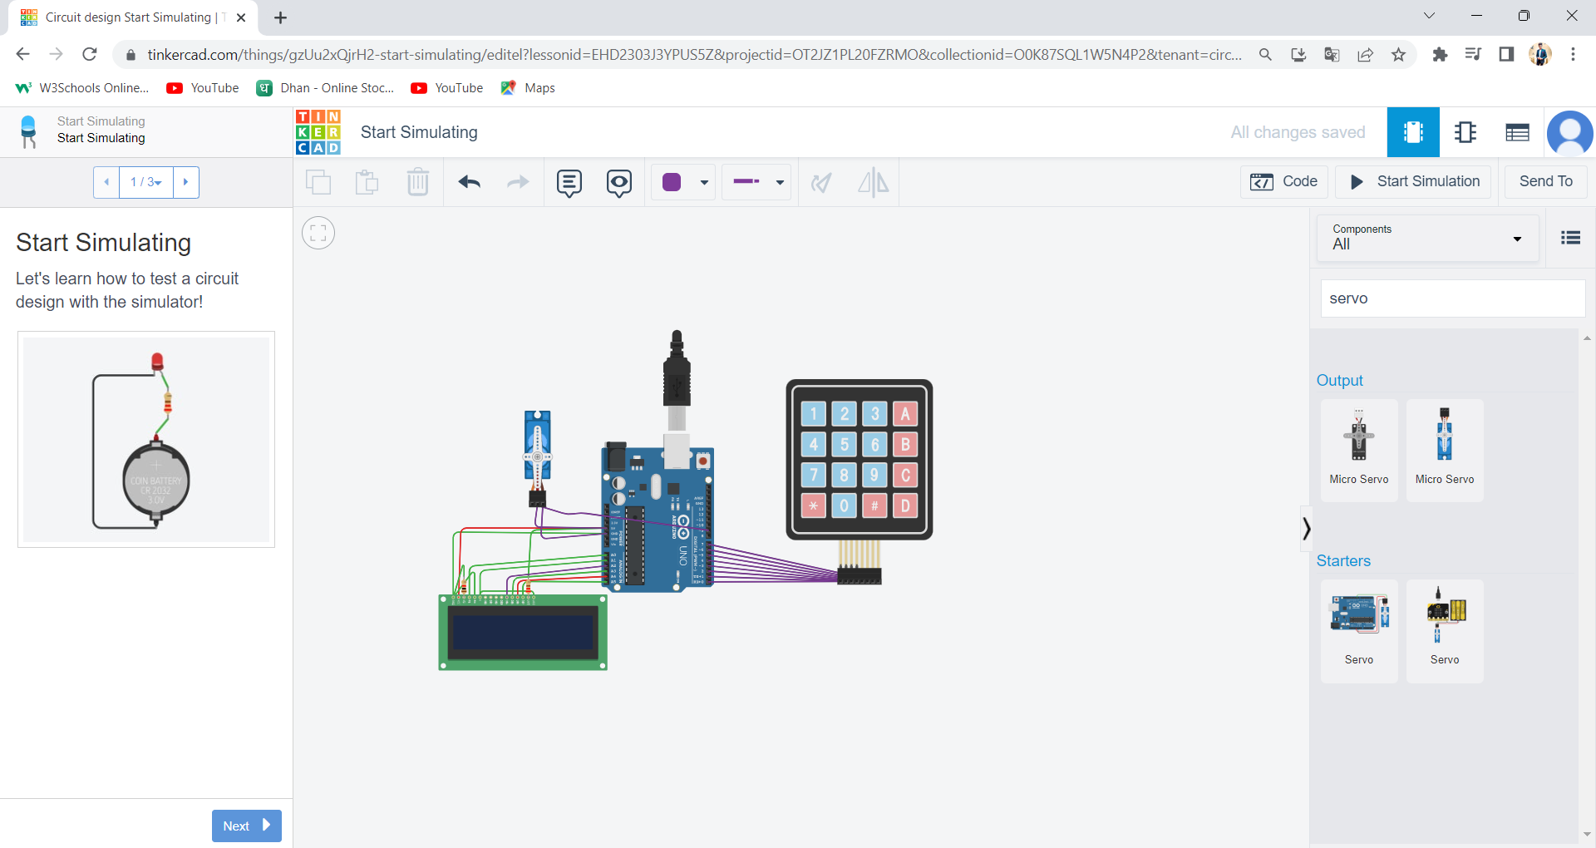
SIMULATION AND TESTING
We have simulated this project on Tinkercad software.
Before Simulation:

Slide 12
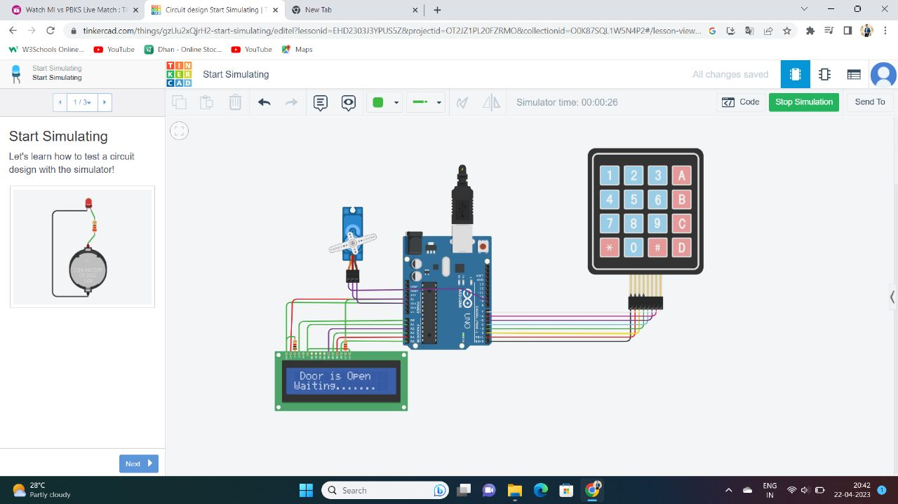
Simulation results
After simulation:

Slide 13
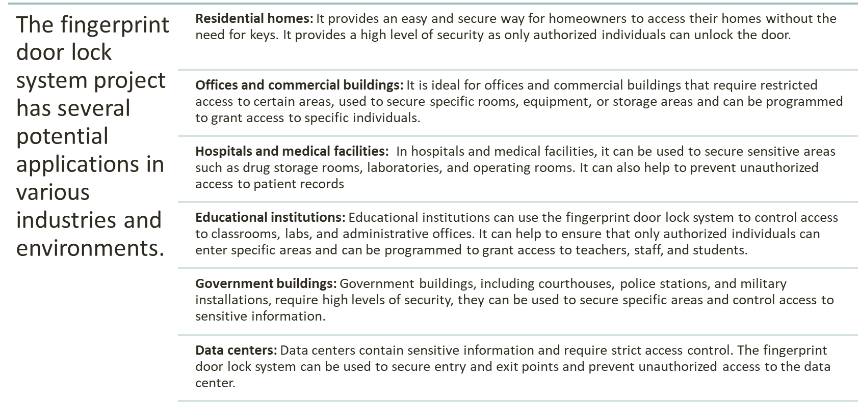
Applications

Slide 14
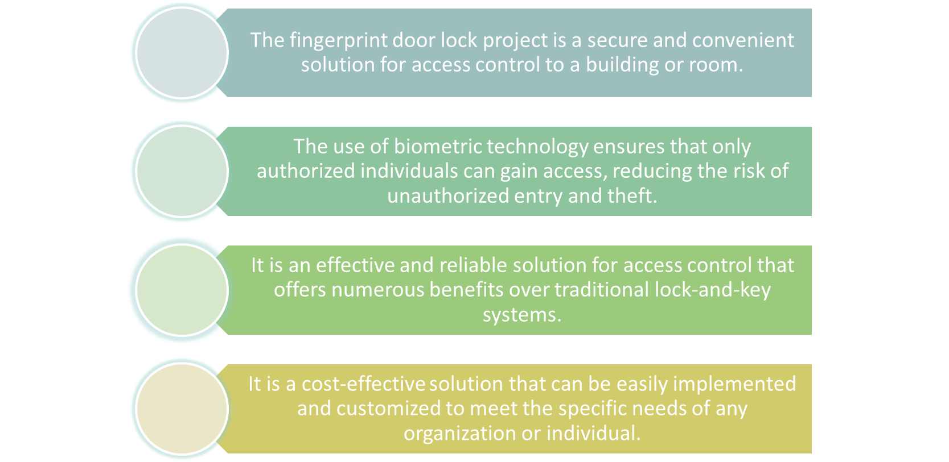
conclusions
1
2
3
4

Slide 15
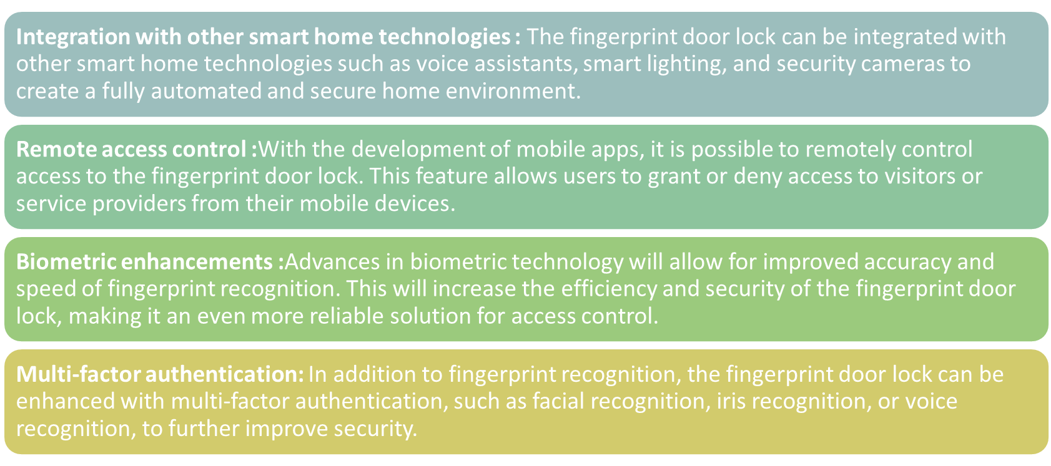
Future scope

Slide 16
REFERENCES
Liu et al ,khan et al
https://www.youtube.com/watch?v=gpXuEghz1zc
www.google.com
https://www.alarmnewengland.com/blog/pros-and-cons-of-fingerprint-door-locks
https://www.safety.com/fingerprint-door-locks/ - Safety.com (article on fingerprint)

Slide 17


